Slide 1
Network Elements Physical Inventory-RAN Prototype
BTS
Node B
E-Node B
BSC
RNC
RAN physical inventory network elements

Slide 2
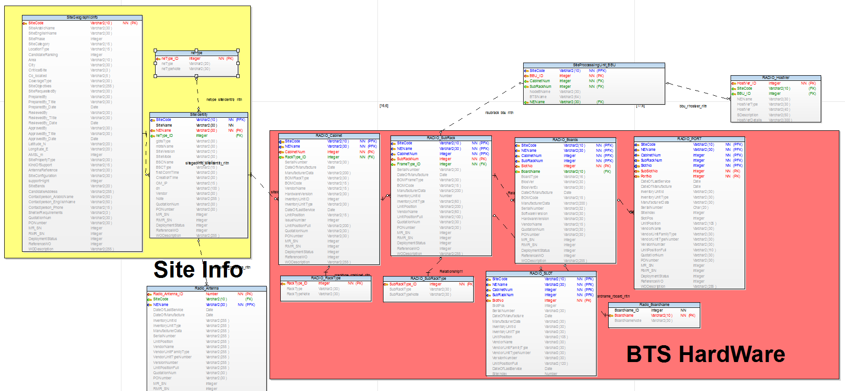

Slide 3
User and Role Management

Slide 4

Resource Inventory Hierarchy
Resource Configuration
Resource Topology
Map Viewer
Create User
Admin will insert user name and the system will get the other information from active directory
User name
Syriatel ID
First name
last name
E-mail
Role
Add

Slide 5


Resource Inventory Hierarchy
Resource Configuration
Resource Topology
Map Viewer
Create Role
Role name :
Create new role
Roles List
Role Name
Admin
Assign permissions

Slide 6

Resource Inventory Hierarchy
Resource Configuration
Resource Topology
Map Viewer
Assign Permissions
Role name : Admin
User & role management
Add user
Delete user
Add role
Create role
Function | Transmission |  |  |  | RAN | CORE | VAS | POWER
 |  | Datacom | DWDM | Microwave
View
Administration panel
Charts
Reports
Add
Add
Add
Edit
Edit
Edit
Deactivate
Deactivate
Deactivate
Generate
Generate
Generate
Export
Export
Export
Generate
Generate
Generate
Export
Export
Export
Assign

Slide 7
Main Information

Slide 8




NE Details
Reports
Charts
Resource Inventory Hierarchy
Resource Configuration
Resource Topology
Map Viewer
>Ran>Radio>Radio site>
RAN
Radio
Radio site (Tejara East )
Antenna
Host version
Rack
Sub rack
Slot
Board
Port
Radio site (Carlton)
Radio site (Mdine)
BSC/RNC
BSC
RNC
BSC/RNC
Transmission
Core
Filter
Radio Site General Information
Browse menu to view radio site components
View general information of radio site
Business related attributes that can be edited
Site Code
Site Name
NE Name
Ne Type | NE Type ID
 | NE Type
 | NE Type Note
gbts Type
mbts Name
Site Version
Site Mode
BSC Name
BSC Type
first Conn Time
Creation Time
OM_IP
Dn
Vendor
Note
Deployment Status
Quotation Num.
PO Number
MR_SN
RMR_SN
Reference WO
WO Description
Inventory Component
Type | Quantity
Rack | 2
Sub rack | 2
Slot | 2
Board | 2
Port | 3
Antenna | 1

Slide 9
View Rack Information

Slide 10
NE Details
Reports
Charts
Resource Inventory Hierarchy
Resource Configuration
Resource Topology
Map Viewer
>Ran>Radio>Radio site>Rack>Rack 1
Rack 1 Attributes
RAN
Radio
Radio site (Tejara East )
Antenna
Host version
Rack
Sub rack
Slot
Board
Port
Radio site (Carlton)
Radio site (Mdine)
BSC/RNC
BSC
RNC
BSC/RNC
Transmission
Core
Filter
Name | Value
NE Name
Site Code
Cabinet Num.
Rack Type | Rack Type ID
 | Rack Type
 | Rack Type Note
Serial Number
Date Of Manufacture
Manufacturer Data
BOM Rack Type
BOM Code
Vendor Name
Hardware Version
Inventory Unit ID
Inventory Unit Type
Date Of Last Service
Unit Position
Issue Number
Deployment Status
Quotation Num.
Rack Information
Rack Name | Rack ID
Rack 1 | 1 | View details
Rack 2 | 2 | View details
Browse radio site all available Racks
View Rack1 attributes
Can edit business related attributes
PO Number
MR_SN
RMR_SN
Reference WO
WO Description

Slide 11
View Sub-rack Information

Slide 12

NE-details
Reports
Charts
Resource Inventory Hierarchy
Resource Configuration
Resource Topology
Map Viewer
>Ran>Radio>Radio site >Sub-Rack>SUB-Rack 1
Sub-rack1 Attributes
RAN
Radio
Radio site (Tejara East )
Antenna
Host version
Rack
Sub rack
Slot
Board
Port
Radio site (Carlton)
Radio site (Mdine)
BSC/RNC
BSC
RNC
BSC/RNC
Transmission
Core
RAN
Radio
Radio site
BTS3900 GSM
BTS3900 GSM 1
Antenna
Rack
Rack 1
Rack 2
Sub rack
Slot
Board
Port
BTS3900 GSM 2
BTS3900 GSM 3
BTS3900A GSM
BSC/RNC
BSC
RNC
BSC/RNC
Transmission
Core
Filter
Name | Value
NE Name
Site Code
Cabinet Num.
Sub Rack Num.
Frame Type ID | Sub Rack Type_ID
 | SubRack Type
 | SubRack Type Note
Serial Number
Date Of Manufacture
BOM Frame Type
BOM Code
Manufacturer Data
Inventory Unit Id
Inventory Unit Type
Unit Position
Vendor Name
Unit Position Full
Deployment Status
Quotation Num.
Sub-racks Information
Sub-rack Name | Sub-rack ID
Sub-rack 1 | 1 | View details
Sub-rack 2 | 2 | View details
Browse radio site all sub racks available
View subrack1 attributes
Can edit business related attributes
PO Number
MR_SN
RMR_SN
Reference WO
WO Description

Slide 13
View Slot Information

Slide 14

NE Details
Reports
Charts
Resource Inventory Hierarchy
Resource Configuration
Resource Topology
Map Viewer
>Ran>Radio>Radio site> Slot>Slot1
RAN
Radio
Radio site (Tejara East )
Antenna
Host version
Rack
Sub rack
Slot
Board
Port
Radio site (Carlton)
Radio site (Mdine)
BSC/RNC
BSC
RNC
BSC/RNC
Transmission
Core
Slot 1 Attributes
Filter
Name | Value
NE Name
Site Code
Cabinet Num.
Sub Rack Num.
Slot No.
Slot Pos.
Serial Number
Date Of Manufacture
Manufacturer Data
Inventory Unit Id
Inventory Unit Type
Unit Position
Vendor Name
Vendor Unit Family Type
Vendor Unit Type
Version Number
Unit Position Full
Date Of Last Service
Site Index
Slots Information
Slots | Slots ID
Slot 1 | 1 | View details
Slot 2 | 2 | View details
Browse radio site all available slots
View slot1 attributes

Slide 15
View Boards Information

Slide 16
NE Details
Reports
Charts
Resource Inventory Hierarchy
Resource Configuration
Resource Topology
Map Viewer
>Ran>Radio>Radio site> Board>Board1
Board 1 Attributes
RAN
Radio
Radio site (Tejara East )
Antenna
Host version
Rack
Sub rack
Slot
Board
Port
Radio site (Carlton)
Radio site (Mdine)
BSC/RNC
BSC
RNC
BSC/RNC
Transmission
Core
Filter
Name | Value
NE Name
Site Code
Cabinet Num.
Sub Rack Num.
SlotNo
Board Name
Board Type | Board Name ID
 | Board Name
 | Board Name Note
Bios Ver.
Bios Ver Ex
Date Of Manufacture
BOM Code
Manufacturer Data
Serial Number
Software Version
Hardware Version
Vendor Name
Deployment Status
Quotation Num.
Boards Information
Board Name | Board ID
Board 1 | 1 | View details
Board 2 | 2 | View details
Browse radio site all available boards
View board1 attributes
Can edit business related attributes
PO Number
MR_SN
RMR_SN
Reference WO
WO Description

Slide 17
View Ports Information

Slide 18
NE Details
Reports
Charts
Resource Inventory Hierarchy
resource configuration
Resource Topology
Map Viewer
>Ran>Radio> Radio site >Port>Port1
Port 1 Attributes
RAN
Radio
Radio site (Tejara East )
Antenna
Host version
Rack
Sub rack
Slot
Board
Port
Radio site (Carlton)
Radio site (Mdine)
BSC/RNC
BSC
RNC
BSC/RNC
Transmission
Core
Name | Value
NE Name
Site Code
Cabinet Num.
Sub Rack Num.
Slot No.
Sub Slot No.
Port No.
Date Of Last Service
Date Of Manufacture
Inventory Unit Id
Inventory Unit Type
Manufacturer Data
Serial Number
Site Index
Slot Pos.
Unit Position
Vendor Name
Vendor Unit Family Type
Vendor Unit Type Number
Version Number
Unit Position Full
Deployment Status
Quotation Num.
Filter
Ports Information
Port Name | Port ID
Port 1 | 1 | View details
Port 2 | 2 | View details
Port 3 | 3 | View details
Browse radio site all available ports
View port1 attributes
Can edit business related attribute
PO Number
MR_SN
RMR_SN
Reference WO
WO Description

Slide 19
View Host Version Module Information

Slide 20
NE Details
Reports
Charts
Resource Inventory Hierarchy
Resource Configuration
Resource Topology
Map Viewer
>Ran>Radio> Radio site > HostVer
RAN
Radio
Radio site (Tejara East )
Antenna
Host version
Rack
Sub rack
Slot
Board
Port
Radio site (Carlton)
Radio site (Mdine)
BSC/RNC
BSC
RNC
BSC/RNC
Transmission
Core
Filter
Host Version Information
Name | Value
Host Ver. ID
SiteCode
BBU_ID
NE Name
HostVerType
Host Ver.
S Description
Host Ver. Details
Browse radio site host version information

Slide 21
View Antenna Information

Slide 22
NE Details
Reports
Charts
Resource Inventory Hierarchy
Resource Configuration
Resource Topology
Map Viewer
>Ran>Radio> Radio site > Antenna
RAN
Radio
Radio site (Tejara East )
Antenna
Host version
Rack
Sub rack
Slot
Board
Port
Radio site (Carlton)
Radio site (Mdine)
BSC/RNC
BSC
RNC
BSC/RNC
Transmission
Core
Filter
Antenna Information
Name | Value
Radio Antenna ID
Site Code
NE Name
Date Of Last Service
Date Of Manufacture
Inventory Unit Id
Inventory Unit Type
Manufacturer Data
Serial Number
Unit Position
Vendor Name
Vendor Unit Family
Vendor Unit Type
Version Number
Unit Position Full
Deployment Status
Quotation Num.
PO Number
MR_SN
RMR_SN
Reference WO
WO Description
Only antenna types available on U2000 will be displayed
View Radio site antenna information

Slide 23
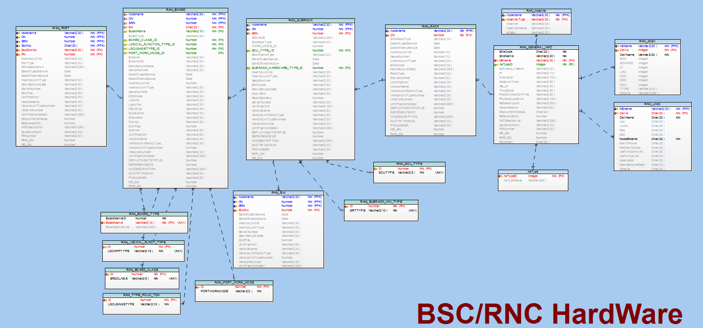

Slide 24
Main Information
BSC/RNC

Slide 25

NE Details
Reports
Charts
Resource Inventory Hierarchy
Resource Configuration
Resource Topology
Map Viewer
>Ran>BSC/RNC>BSC>BSC1
RAN
Radio
BSC/RNC
BSC
BSC 1
Host version
Rack
Sub rack
Slot
Board
Port
RNC
BSC/RNC
Transmission
Core
BSC1 Attributes
Filter
Browse menu to view BSC1 components
View general information of BSC1
Business related attributes that can be edited
Site Code
Site Name
NE Name
NE Type | Ne Type ID
 | Ne Type Name
Software Version
IP
Internal ID
Creation Time
NE dn
Time Zone
First Connection Time
Physical Location
NE Description
Vendor Name
Deployment Status
Quotation Num.
PO Number
MR_SN
RMR_SN
Reference WO
WO Description
Inventory Component
Type | Quantity
Rack | 2
Sub rack | 2
Slot | 2
Board | 2
Port | 3

Slide 26
View Rack Information

Slide 27
NE Details
Reports
Charts
Resource Inventory Hierarchy
Resource Configuration
Resource Topology
Map Viewer
>Ran>BSC/RNC>BSC>BSC1>Rack
Rack 1 Attributes
RAN
Radio
BSC/RNC
BSC
BSC 1
Host version
Rack
Sub rack
Slot
Board
Port
RNC
BSC/RNC
Transmission
Core
Name | Value
NE Name
Node Name
Rack Type
Serial Number
Date Of Manufacture
Manufacturer Data
BOM Rack Type
BOM Code
Vendor Name
Vendor Unit Family Type
Vendor Unit Type Number
Version Number
Hardware Version
Inventory Unit ID
Inventory Unit Type
Date Of Last Service
Unit Position
Unit Position Detail
Issue Number
Deployment Status
Quotation Num.
Filter
Racks Information
Rack Name | Rack ID
Rack 1 | 1 | View details
Rack 2 | 2 | View details
Browse BSC1 all available racks
View rack1 attributes
Can edit business related attributes
PO Number
MR_SN
RMR_SN
Reference WO
WO Description

Slide 28
View Sub-rack Information

Slide 29
NE Details
Reports
Charts
Resource Inventory
Hierarchy
Resource Configuration
Resource Topology
Map Viewer
>Ran>BSC/RNC>BSC>BSC1>Sub-rack
Sub-rack 1 Attributes
Name | Value
NE Name
Node Name
Cabinet Number
sub rack Number
SR Name
Sub Rack Type
WORK_MODE_ID
SCU_TYPE | ID
 | SCU Type
BOM Frame Type
Date Of Last Service
Date Of Manufacture
SUBRACK_HARDWARE_TYPE | ID
 | Subrack Hardware Type
Inventory Unit Id
Inventory Unit Type
Issue Number
BOM Code
Manufacturer Data
Module No.
Rack Frame No.
Serial Number
Unit Position
Vendor Name
Vendor Unit Family Type
Vendor Unit Type
Version Number
Unit Position Detail
RAN
Radio
BSC/RNC
BSC
BSC 1
Host version
Rack
Sub rack
Slot
Board
Port
RNC
BSC/RNC
Transmission
Core
Filter
Sub-racks Information
Sub-rack Name | Rack ID
Sub-rack 1 | 1 | View details
Sub-rack 2 | 2 | View details
Browse BSC1 all available sub-racks
View sub-rack1 attributes
Can edit business related attributes
PO Number
MR_SN
RMR_SN
Reference WO
WO Description

Slide 30
View Slot Information

Slide 31
NE Details
Reports
Charts
Resource Inventory Hierarchy
Resource Configuration
Resource Topology
Map Viewer
>Ran>BSC/RNC>BSC>BSC1>Slot
RAN
Radio
BSC/RNC
BSC
BSC 1
Host version
Rack
Sub rack
Slot
Board
Port
RNC
BSC/RNC
Transmission
Core
Slots 1 Attributes
Filter
Name | Value
NE Name
Node Name
Cabinet Number
sub rack Number
Slot No.
Date Of Last Service
Date Of Manufacture
Inventory Unit Id
Inventory Unit Type
Serial Number
Manufacturer Data
Slot Pos.
Unit Position
Vendor Name
Vendor Unit Family Type
Vendor Unit Type Number
Version Number
Unit Position Detail
Slots Information
Slot Name | Rack ID
Slot 1 | 1 | View details
Slot 2 | 2 | View details
Browse BSC1 all available slots
View slot1 attributes
Can edit business related attributes

Slide 32
View Boards Information

Slide 33
NE Details
Reports
Charts
Resource Inventory Hierarchy
Resource Configuration
Resource Topology
Map Viewer
>Ran>BSC/RNC>BSC>BSC1>Board
Board 1 Attributes
Name | Value
NE Name
Node Name
Cabinet Number
sub rack Number
SN
Board Name
Board Type
BOARD_CLASS_ID
LOGICAL_FUNCTION_TYPE_ID
LGCUSAGETYPE_ID
PORT_WORK_MODE_ID
Bios Ver.
Bios Ver. Ex
Manufacturer Data
Serial Number
Date Of Last Service
Date Of Manufacture
Inventory Unit Id
Inventory Unit Type
Issue Number
BOM Code
LAN Ver.
Logic Ver.
MBUS Ver.
Sub Slot No.
Module No.
Port No.
Slot Pos.
Soft Ver.
Unit Position
Vendor Name
Vendor Unit Family Type
Vendor Unit Type Number
Version Number
 | Board Name ID
 | Board Name
 | Board Name Note
RAN
Radio
BSC/RNC
BSC
BSC 1
Host version
Rack
Sub rack
Slot
Board
Port
RNC
BSC/RNC
Transmission
Core
Filter
Boards Information
Board Name | Board ID
Board 1 | 1 | View details
Board 2 | 2 | View details
Browse BSC1 all available boards
View board1 attributes
Can edit business related attributes
PO Number
MR_SN
RMR_SN
Reference WO
WO Description

Slide 34
View Ports Information

Slide 35
NE Details
Reports
Charts
Resource Inventory Hierarchy
Resource Configuration
Resource Topology
Map Viewer
>Ran>BSC/RNC>BSC>BSC1> Port
Port 1 Attributes
RAN
Radio
BSC/RNC
BSC
BSC 1
Host version
Rack
Sub rack
Slot
Board
Port
RNC
BSC/RNC
Transmission
Core
Name | Value
NE Name
Node Name
Cabinet Number.
Sub Rack Number.
Slot No.
Sub Slot No.
Port No.
Port Type
Port Description
Date Of Last Service
Date Of Manufacture
Inventory Unit Id
Inventory Unit Type
Manufacturer Data
Serial Number
Slot Pos.
Unit Position
Vendor Name
Vendor Unit Family Type
Vendor Unit Type Number
Version Number
Unit Position Detail
Deployment Status
Quotation Num.
Ports Information
Port Name | Port ID
Port 1 | 1 | View details
Port 2 | 2 | View details
Port 3 | 3 | View details
Browse BSC1 all available ports
View port1 attributes
Can edit business related attributes
PO Number
MR_SN
RMR_SN
Reference WO
WO Description

Slide 36
View Host Version Module Information

Slide 37
NE Details
Reports
Charts
Resource Inventory Hierarchy
Resource Configuration
Resource Topology
Map Viewer
> Ran>BSC/RNC>BSC>BSC1> > HostVer
RAN
Radio
BSC/RNC
BSC
BSC 1
Host version
Rack
Sub rack
Slot
Board
Port
RNC
BSC/RNC
Transmission
Core
Host Version Information
Name | Value
Node Name
Host Ver. Type
Host Ver.
Host Ver. Name
S Desc
Browse BSC1 host version information

Slide 38
Resource Inventory Hierarchy
Resource Configuration
Resource Topology
Map Viewer
Network Elements Physical Inventory –RAN- Administration Panel
Select Network Element
BTS
Administration panel to browse and add HW component types
Select Item
Boards
Board Name ID | Board Name | Board Name Note
 |  |  | Edit | Deactivate
 |  |  | Edit | Deactivate
 |  |  | Edit | Deactivate
Add New Board

Slide 39
Resource Inventory Hierarchy
Resource Configuration
Resource Topology
Map Viewer
Network Elements Physical Inventory –RAN- Administration Panel
Add New Board Name
Board Name ID
ID
Board Name
Board Name Note
Save
Cancel

Slide 40
Resource Inventory Hierarchy
Resource Configuration
Resource Topology
Map Viewer
Network Elements Physical Inventory –RAN- Administration Panel
Add New Sub rack Type
Sub rack Type ID
ID
Sub rack Type
Sub rack Type Note
Save
Cancel

Slide 41
Resource Inventory Hierarchy
Resource Configuration
Resource Topology
Map Viewer
Network Elements Physical Inventory –RAN- Administration Panel
Add New Rack Type
Rack Type ID
ID
Rack Type
Rack Type Note
Save
Cancel

Slide 42
Resource Inventory Hierarchy
Resource Configuration
Resource Topology
Map Viewer
Network Elements Physical Inventory –RAN- Administration Panel
Add New NE Type
NE Type ID
ID
NE Type Name
Save
Cancel

Slide 43
Generate Reports

Slide 44

NE Details
Reports
Charts
Resource Inventory Hierarchy
Resource Configuration
Resource Topology
Map Viewer
Category Reports
Global Reports
Generate Reports
Select category /sub category
Category :
Location and Site filter :
Location filter
Region :
Area :
Zone:
Sub Area:
Site filters:
Site code:
Site name:
Select your report columns (Attributes) :
Attributes :
NE Attributes :
Select NE type :
Types :
Radio
Radio Rack types
U
Radio Sub rack types
G
Radio Board types
L
Radio slot types
Radio port types

Slide 45
NE Details
Reports
Charts
Resource Inventory Hierarchy
Resource Configuration
Resource Topology
Map Viewer
Category Reports
Global Reports
Generate Reports
Select category /sub category
Location and Site filter :
Location filter
Region :
Area :
Zone:
Sub Area:
Site filters:
Site code:
Site name:
Select NE levels :
Select NE type :
Types :
NE Category
Radio
Radio Rack types
NE
U
Rack
Radio Sub rack types
G
Radio Board types
Sub rack
L
Board
Radio slot types
Slot
Radio port types
BSC /RNC
Port

Slide 46
Generate Charts

Slide 47
NE Details
Reports
Charts
Resource Inventory Hierarchy
Resource Configuration
Resource Topology
Map Viewer
Toggle chart
Generate chart
Select category /sub category
Location and Site filter :
Location filter
Region :
Area :
Zone:
Sub Area:
Site filters:
Site code:
Site name:
Select NE levels :
NE Category
Radio
NE
U
Rack
G
Sub rack
L
Board
Slot
BSC /RNC
Port

